Slide 1

Presentation: 6 December 2021
A full stack application developed by:
Konnen Hannaford
Zac Hobba
Mark Watson

Slide 2
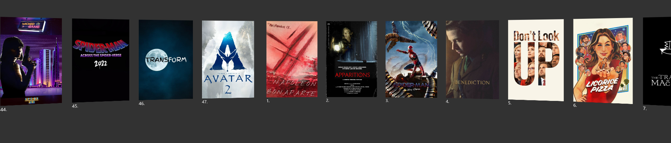
ELEVATOR PITCH
Movie releases are sometimes hard to track without accessing movie industry news. This application provides movie lovers with a convenient tool to quickly get updated on movie release dates for the next 12 months.

Slide 3
CONCEPT
USER STORY
As an avid but busy moviegoer
I WANT to keep informed about upcoming movies
SO THAT I can plan to see upcoming releases more often

Slide 4
CONCEPT
ACCEPTANCE CRITERIA
GIVEN a movie database app
WHEN I drag the mouse, the movie carousel rotates to each movie poster
WHEN I hover over a movie poster
THEN I am presented with the movie name, release date
WHEN I click on a movie poster
THEN I am presented with the movie name, release date, overview, genres and an option to add to my watchlist
WHEN I add the movie to my watchlist
THEN I can view my watchlist and set email reminders for my selected movies.

Slide 5
PROCESS – TASK SPLIT
We wanted to create an app where you can easily see the upcoming movies and schedule email reminders for them.
Mark mySQL, controllers, models, views, Javascript, found and implemented the poster animation, found TMDB api for the movie seed data.
Zac Models, nodeMailer setup and functions, some of the Javascript and helped with styling
Konnen Javascript and styling, setting up models, handlebars and controllers.

Slide 6
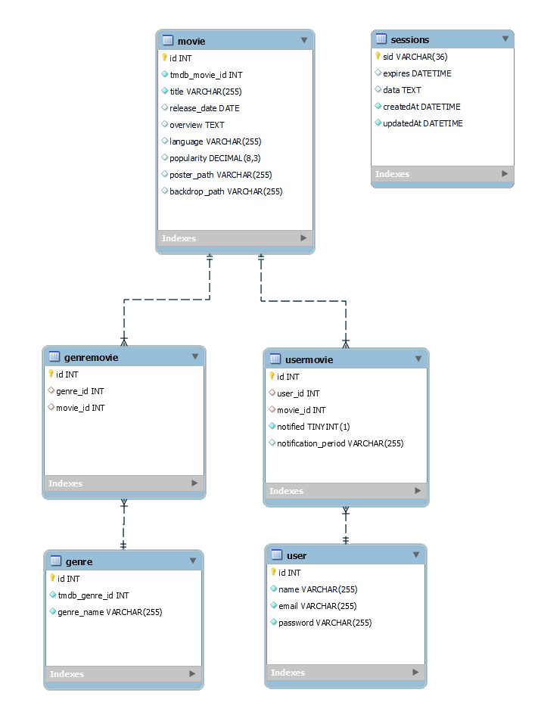
THE DATABASE STRUCTURE

Slide 7
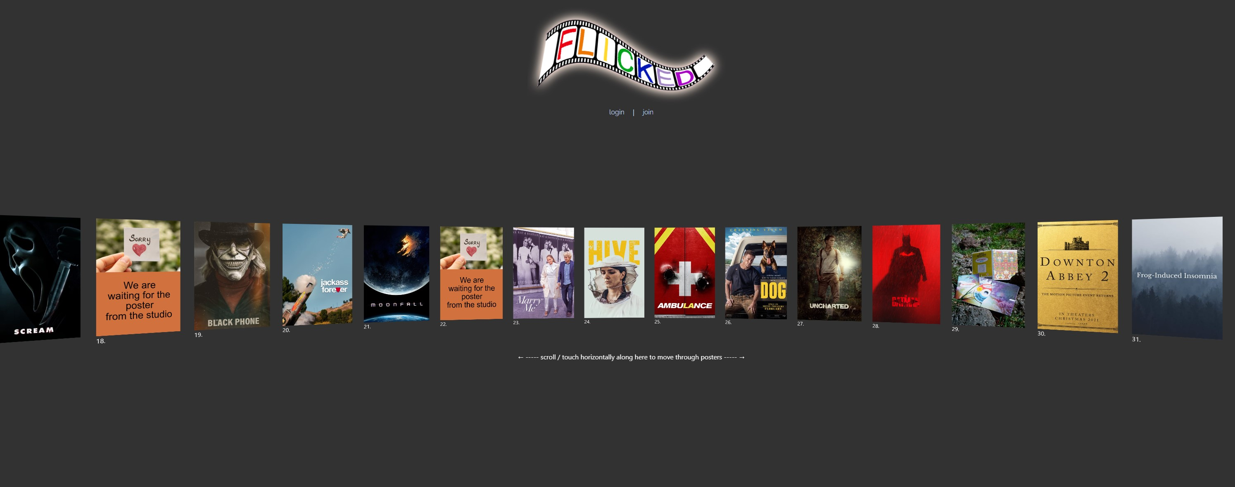
APPLICATION DEMO

Slide 8
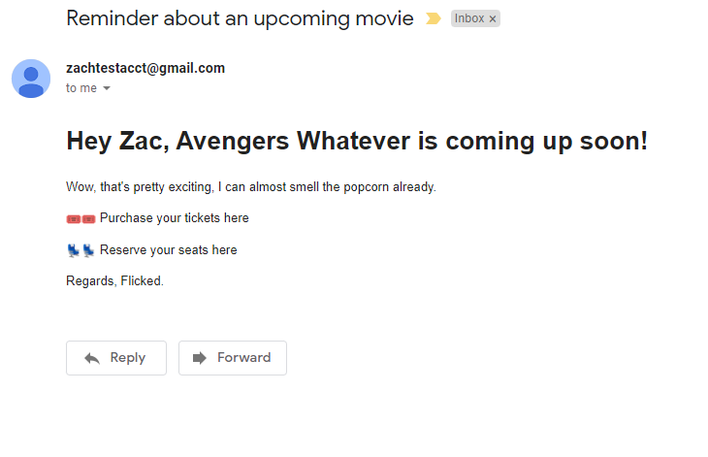
TEST EMAIL

Slide 9
TECHNOLOGY USED
Node.js
Express.js
Sequelize
Handlebars
GSAP (Green Sock Animation Platform)
Heroku
NodeMailer
MySQL

Slide 10
FUTURE IDEAS
Add filter by genre on landing page.
Add filter by date on landing page.
Implement fully functioning email notification. Actual system would involve CRON linked with algorithms to manage automatic issuing emails.
Auto update movie data with Fetch call by server that updates the SQL database.

Slide 11
PROBLEMS EXPERIENCED
Finding an free animation plug in to manage the posters how we wanted. The Green Sock animation platform has a number of issues but by far was the best.
Limited knowledge of Sequelize and getting it to do the database queries needed.
Usual Git headaches.
NodeMailer: the host for sending the emails requires lower security for NodeMailer to interface and send emails from.
Seeding the database.
Lack of time to implement all features we wanted.

Slide 12
DEPLOYMENT DETAILS
Github Repo:
https://github.com/Mark33Mark/movie-scheduler
Website: https://flick3d.herokuapp.com

